Slide 1

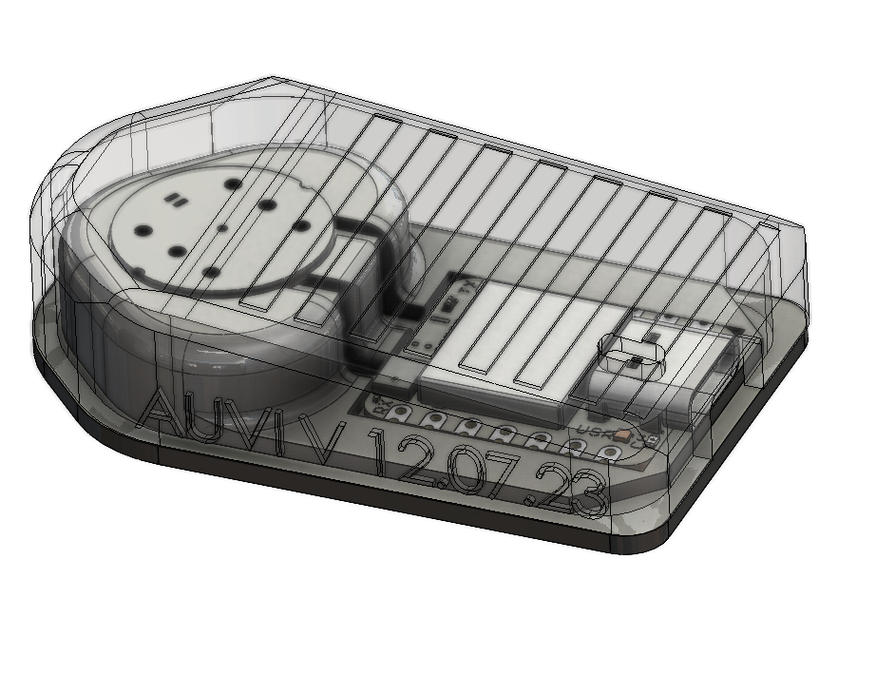
Kasperek, Szymon R

Slide 2
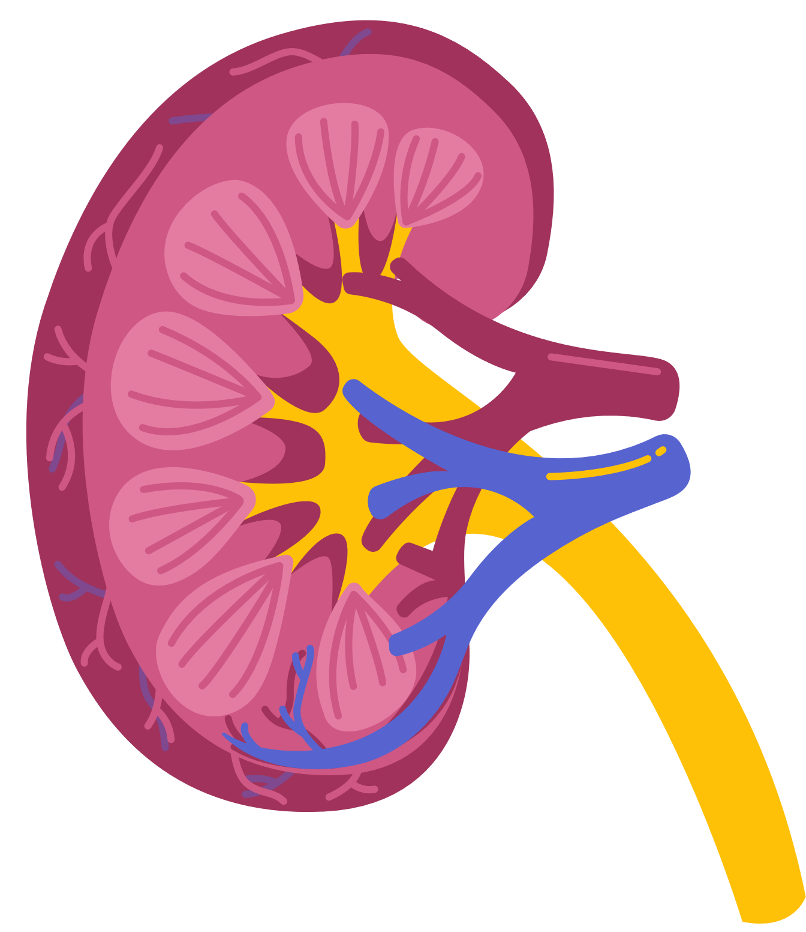
Clinical Background
End-Stage Renal Disease
Poor outcomes
ESRD is the final manifestation of chronic kidney disease and has significant implications on long-term survival and requires hemodialysis.
557,000
Patients in the United States reliant on hemodialysis.

Slide 3
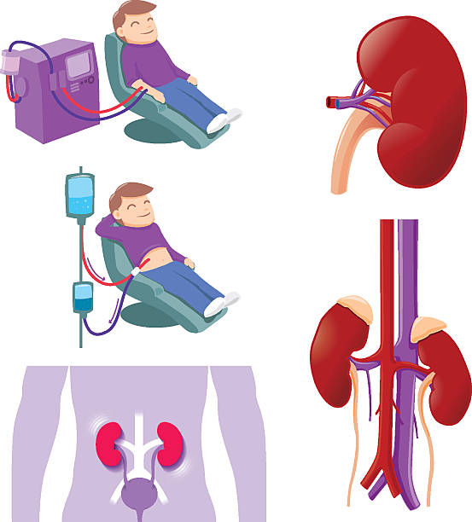
Hemodialysis
400ml/min
the average rate of dialysis in the United States.
Exhausting
Having your entire blood volume circulating through a machine exacts a toll on the human body.
Requires "Access"
You don't just "start" hemodialysis. A series of events needs to happen to create a suitable "access" site for hemodialysis.
The last resort.

Slide 4
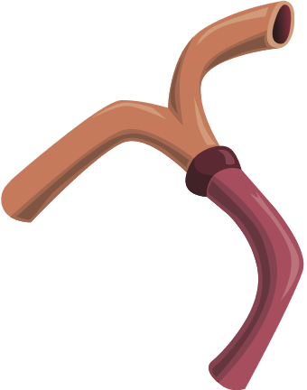
Maturation: a Clinical Problem
40%
Fail within 1 year
Stenosis/Thrombosis
are the leading causes of failure.
48 hours
The accepted duration of time where modern techniques can salvage an acutely thrombosed fistula.

Slide 5



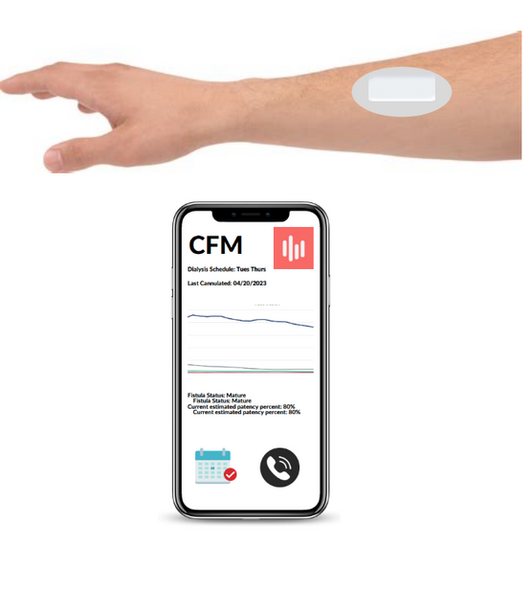

Solution
Uses auditory signals and intermittent signal collection to monitor for AVF stenosis/thrombosis
Notes:
Solution: wearable device that transmits signals to a cloud based system that would notify a physician and/or

Slide 6




 | Audio Engineering |  | Software Development
 | Signal processing, acoustic optimization of the device. |  | AUVI currently uses an “audio engine” which needs further development.
 | Electrical engineering |  | This project is needed, interdisciplinary, and funded.
 | Microcontroller, custom boards, PCB design.
01
02
Your Role
03
Notes:
Talk about the “Thrill” and how fistulas are distinguished.

Slide 7

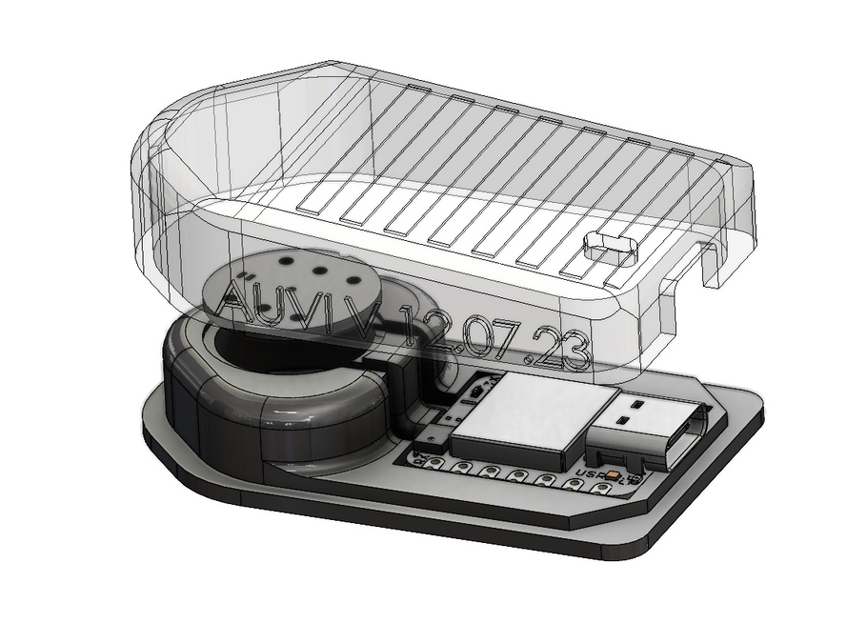
Value Added to YOU.
01 | Develop Early-stage technology
 | Prototyping, patents, freedom to innovate.
02 | Engage with Commercialization
 | Support from the medical school for commercialization. Passionate founders. The project has significant interest in vascular surgery and interventional radiology societies.
03 | Create Impactful Technology
 | Your developments can help save lives and improve quality of life for patients
Notes:
Talk about how students have funding.

Slide 8
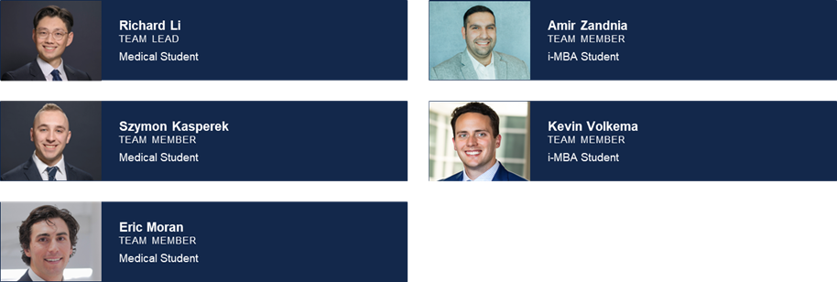
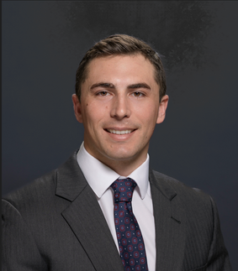
Contact: ericm6@illinois.edu

